Slide 1
ABEGUNRIN GIDEON EcoFoodSystems Ph.D. 2023
Interdisciplinary research on climate-resilient agroecological transitions of city regional food systems

Slide 2
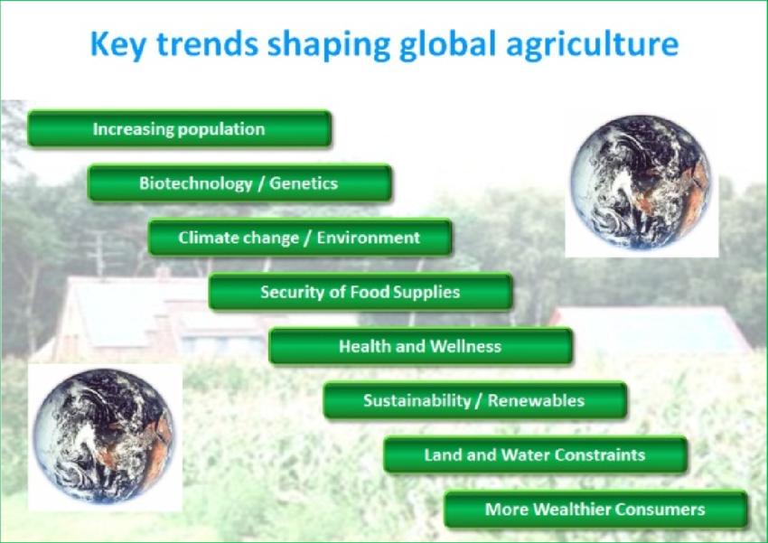
Introduction
According to the FAO (2017), there are variety of global trends influencing agricultural and food production, and they are demographic change, increase in population, poverty, climate change and the overall sustainability of food and agricultural systems.
As revealed in UNEP (2013), climate change is one of the greatest environmental concerns globally, and it has added more to factor that menaces efforts at ensuring sustainability of food and agricultural systems.
This therefore necessitates research on climate resilient agro-ecological transitions of city regional food systems.
Source: https://www.researchgate.net/figure/Key-global-trends-shaping-the-agricultural-sector-6_fig1_277022097
Notes:
References
FAO. (2017). The future of food and agriculture; Trends and challenges.
United Nations Environmental Problem (UNEP). (2013). Climate change-home.
http://www.unep.org/climatechange

Slide 3
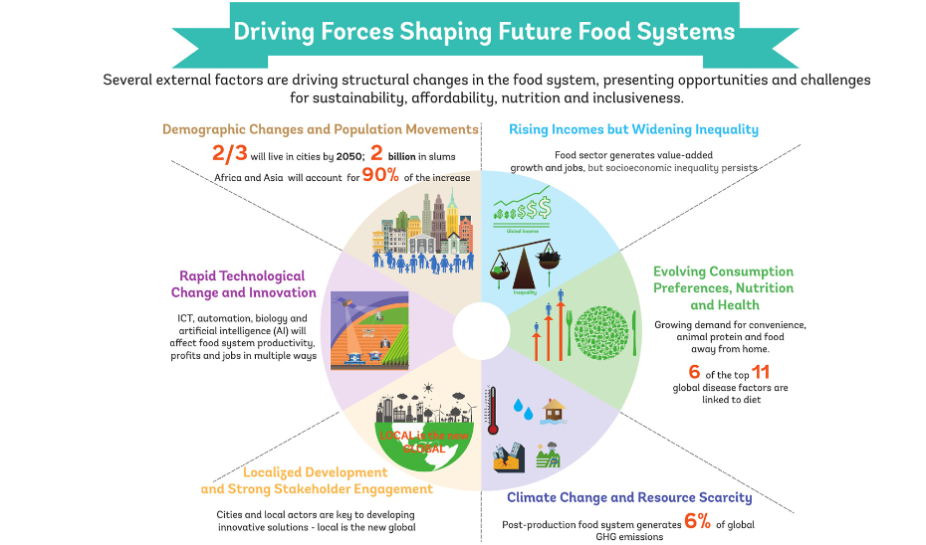
Impetus of the Research
To achieve this, there is a need to aggregate and integrate data and research on climate related elements, demographic changes, health related data, data on economic indices.
Consequentially, all these can then be deployed to develop sub-national decision support dashboards and decision support tools for stakeholders in the food systems.
This research will prove pivotal for international bodies devoted to the Eco Food Systems, stakeholders, end-users and beneficiaries in the food system of cities and policy makers.
Source: FAO 2018b
Notes:
Food and Agriculture Organization of the United Nations. (2018b). Transforming our approach to urban food issues. http://www.fao.org/supportto-investment/news/detail/en/c/1159329/

